Slide 1
UPI Based Financial Fraud Detection Using Deep Learning Approach

Slide 2
Abstract
The UPI-Based Financial Fraud Detection Using Deep Learning Approach project aims to enhance the security of digital payments by detecting fraudulent transactions in real-time. Leveraging deep learning models like LSTM, CNN, and Autoencoders, the system analyzes transaction patterns and identifies anomalies with high accuracy. It reduces financial fraud by blocking suspicious activities within milliseconds, ensuring secure transactions. The model adapts to evolving fraud tactics using AI-driven risk assessment and behavioral analytics. This project provides a scalable, efficient, and reliable fraud detection system for financial institutions and digital payment platforms.

Slide 3
Introduction
With the rise of digital payments, UPI transactions have become a prime target for financial fraud. Traditional rule-based fraud detection methods struggle to adapt to evolving fraud tactics. This project leverages deep learning algorithms like LSTM and CNN to analyze transaction patterns and detect anomalies in real-time. By integrating AI-driven risk assessment, the system ensures secure and efficient fraud prevention. The proposed model enhances financial security, minimizes fraud losses, and improves user trust in digital payment systems.

Slide 4
Existing System
Traditional fraud detection systems rely on rule-based approaches and manual transaction monitoring, which are inefficient against evolving fraud tactics. These systems generate high false positives, leading to unnecessary transaction blocks and poor user experience. Machine learning-based fraud detection is used in some financial institutions but lacks real-time adaptability. Static threshold-based security measures fail to detect sophisticated fraud patterns like phishing and identity theft. Due to these limitations, a deep learning-driven fraud detection system is required for accurate, real-time prevention.

Slide 5
Proposed System
The proposed system uses deep learning algorithms like LSTM, CNN, and Autoencoders to detect fraudulent UPI transactions in real-time. It analyzes transaction patterns, user behavior, and anomaly detection to minimize false positives. The system continuously learns and adapts to new fraud techniques using AI-driven risk assessment. By integrating real-time monitoring and predictive analytics, it enhances security and prevents financial losses. This intelligent, scalable, and efficient fraud detection model ensures safer digital transactions.

Slide 6
LITERATURE REVIEW
Several research studies highlight the use of machine learning and deep learning for financial fraud detection. Traditional methods like rule-based systems and statistical models struggle to detect evolving fraud patterns. Recent advancements in AI-driven anomaly detection, LSTMs, and Autoencoders have improved fraud identification accuracy. Studies show that real-time fraud detection using deep learning significantly reduces false positives. This project builds upon these findings to develop a more adaptive and efficient fraud prevention system for UPI transactions.

Slide 7
Modules for PPT
Data Preprocessing – The raw UPI transaction data is cleaned, normalized, and structured to remove inconsistencies, missing values, and outliers for accurate fraud detection.
Feature Extraction & Classification – Key transaction attributes like transaction amount, frequency, location, and user behavior are extracted and classified using deep learning models like LSTM and CNN.
RGB Composite & Band Selection – Multi-dimensional data visualization techniques are used to enhance fraud pattern detection by selecting relevant transaction features and highlighting suspicious activities.
Interactive Visualization – Real-time dashboards and fraud heatmaps provide an intuitive view of transactions, enabling instant anomaly detection and fraud trend analysis.
Model Deployment & Performance Analysis – The trained fraud detection model is deployed for real-time monitoring, and its accuracy, precision, recall, and F1-score are evaluated to optimize performance.

Slide 8
Algorithms Used for PPT
Convolutional Neural Networks (CNNs) – Used for pattern recognition in transaction data, identifying fraudulent behaviors by analyzing sequential transaction features.
Principal Component Analysis (PCA) – Reduces dimensionality by extracting the most significant transaction features, improving fraud detection efficiency.
Softmax Classifier – Converts fraud probability scores into categorical labels, enabling precise classification of normal and fraudulent transactions.
Data Augmentation Techniques – Enhances model robustness by generating synthetic fraudulent transaction patterns, improving detection accuracy.
Adam Optimizer & Cross-Entropy Loss – Ensures faster convergence and accurate fraud classification, optimizing the deep learning model's performance.

Slide 9
Software Components:
Programming Language: Python (for AI model development and data processing)
Frameworks & Libraries:
TensorFlow/Keras or PyTorch – Deep learning frameworks for fraud detection modeling
OpenCV – Used for image/video-based security analysis (if needed)
Scikit-learn – Machine learning algorithms for fraud classification
Pandas & NumPy – Data preprocessing, manipulation, and feature engineering
Matplotlib & Seaborn – Data visualization for fraud detection insights
Streamlit – Interactive web-based dashboard for real-time fraud monitoring
Hardware Components:
Processor: Intel Core i7/i9 or AMD Ryzen 7/9 (for high-speed computation)
RAM: Minimum 16GB (Recommended: 32GB for large-scale fraud detection)
Storage: SSD (512GB or more for faster data access)
GPU (Highly Recommended): NVIDIA RTX 3060+ or Tesla GPUs (for deep learning acceleration)
Cloud GPU (Optional for Deployment): Google Colab, AWS, or Azure (for scalable fraud detection in real-world applications)

Slide 10
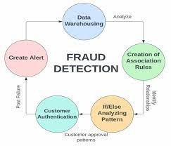
Block Diagram

Slide 11
UML Diagrams
Use Case Diagram
Data Flow Diagram
Sequence Diagram
Active Diagram

Slide 12
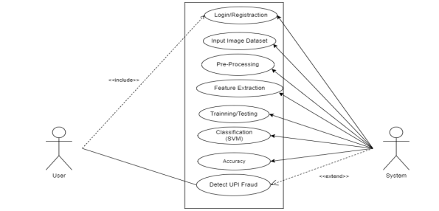
Use Case Diagram

Slide 13
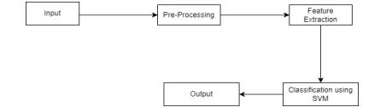
Data Flow Diagram

Slide 14
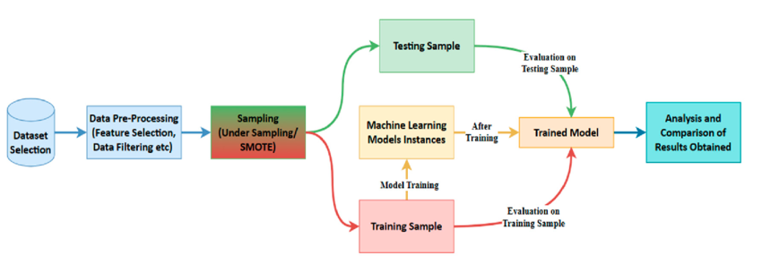
Sequence Diagram

Slide 15
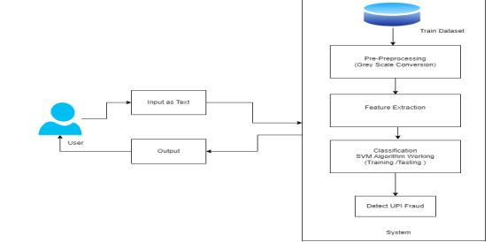
Active Diagram

Slide 16
Final Output
The UPI-Based Financial Fraud Detection System successfully identifies fraudulent transactions in real-time using deep learning models like LSTM, CNN, and Autoencoders. The system processes transaction data, extracts key features, and classifies transactions as genuine or fraudulent with high accuracy. An interactive dashboard provides real-time monitoring, visualizing suspicious activities through fraud heatmaps and anomaly detection reports. The deployed model achieves optimized precision, recall, and F1-score, reducing false positives while ensuring secure transactions. This AI-powered solution enhances financial security, minimizes fraud risks, and builds trust in digital payment ecosystems.

Slide 17
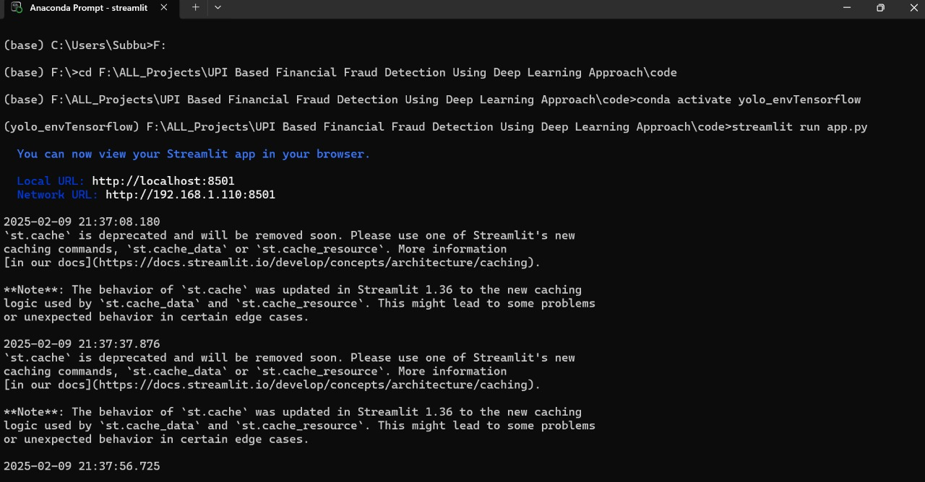
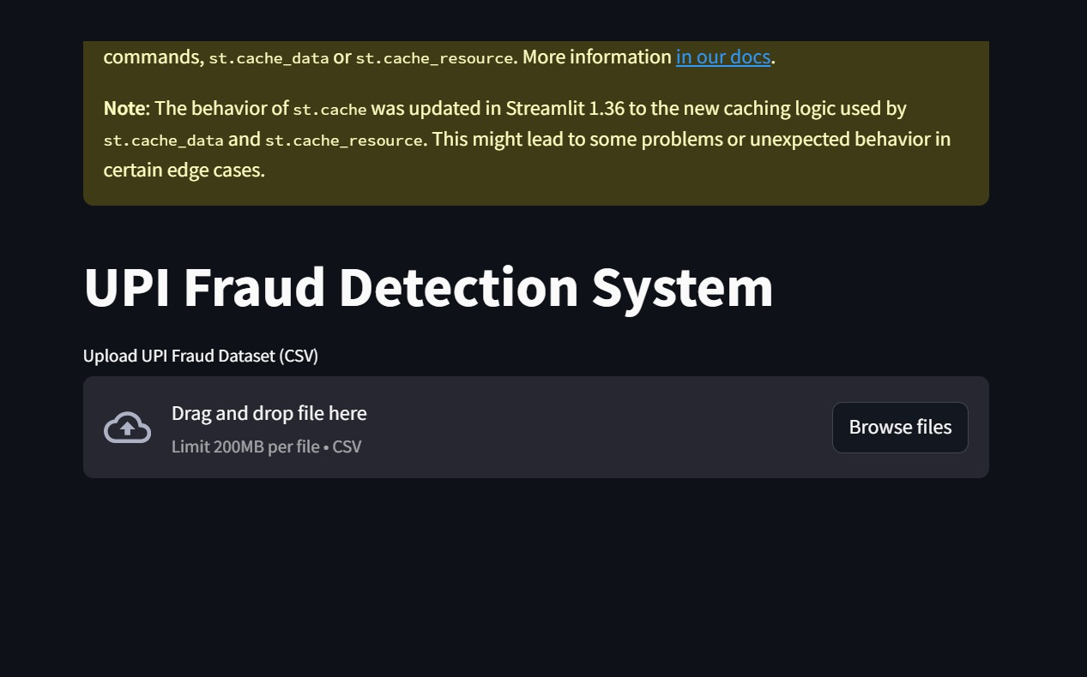
Final Output

Slide 18
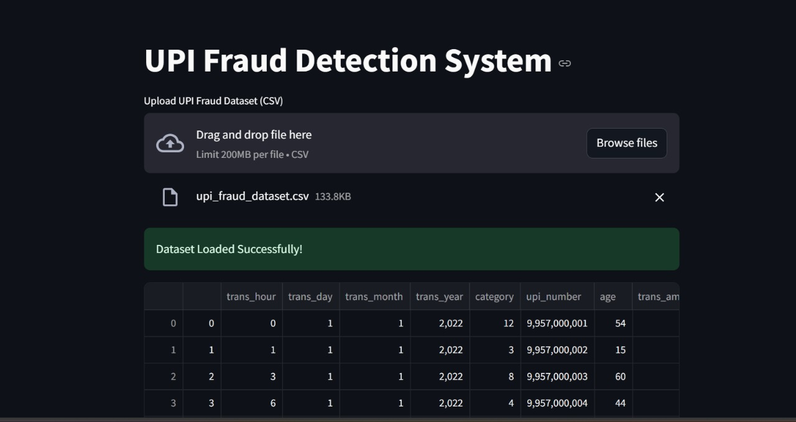

Final Output

Slide 19
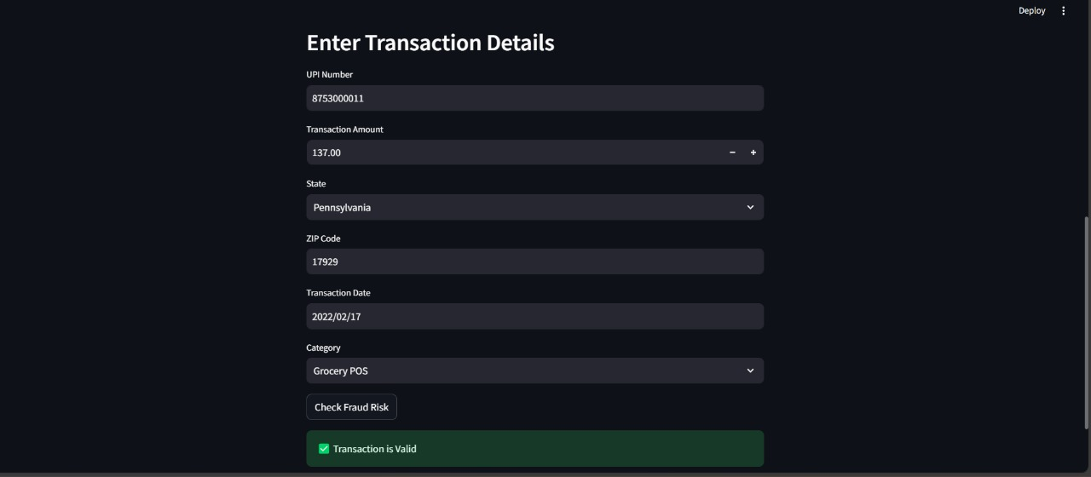
Final Output

Slide 20
Conclusion
The UPI-Based Financial Fraud Detection System provides a robust and intelligent approach to identifying fraudulent transactions in real-time using deep learning techniques. By leveraging LSTM, CNN, and anomaly detection models, the system accurately detects suspicious activities while minimizing false positives. The integration of AI-driven risk assessment and real-time monitoring ensures enhanced financial security and user trust in digital transactions. With continuous learning and adaptability, this system effectively counters evolving fraud tactics. This project contributes to a safer, more reliable UPI payment ecosystem, reducing financial losses and enhancing fraud prevention strategies.

